Slide 1
Batching Techniques for Accumulators with Applications to IOPs and Stateless Blockchains
Dan Boneh, Benedikt B¨unz, and Ben Fisch
CRYPTO 2019
2021年02月05日

Slide 2
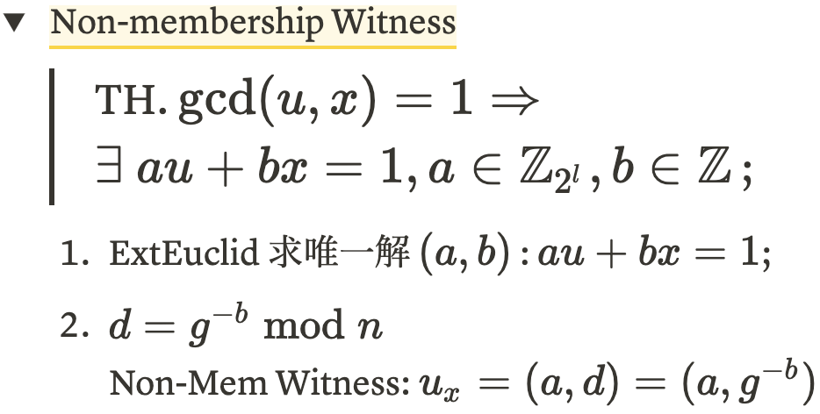
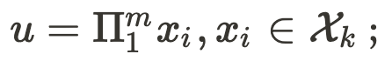
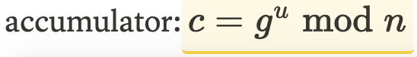
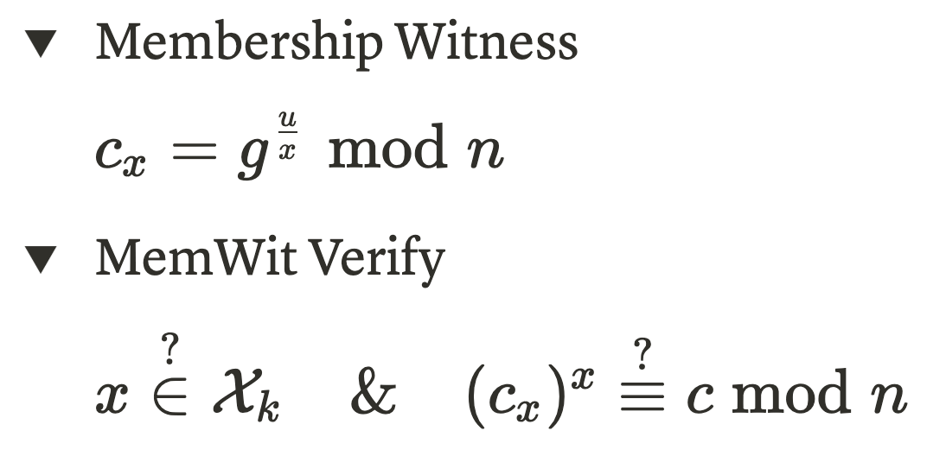
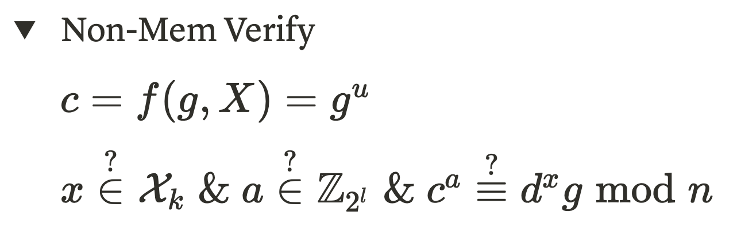
Universal Accumulator[LLX07]
Without Trust Setup
Jiangtao Li, Ninghui Li, and Rui Xue, “Universal Accumulators with Efficient Nonmembership Proofs,” in Applied Cryptography and Network Security, ed. Jonathan Katz and Moti Yung, vol. 4521, Lecture Notes in Computer Science (Berlin, Heidelberg: Springer Berlin Heidelberg, 2007), 253–69, https://doi.org/10.1007/978-3-540-72738-5_17.

Slide 3
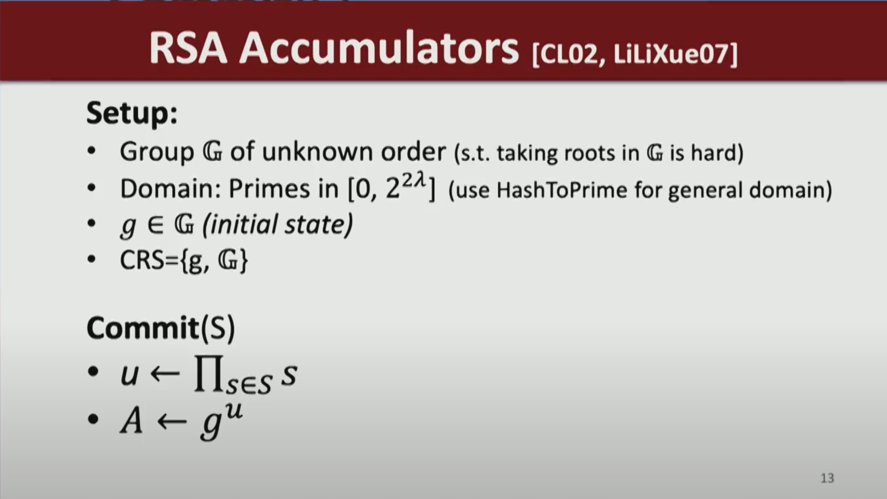
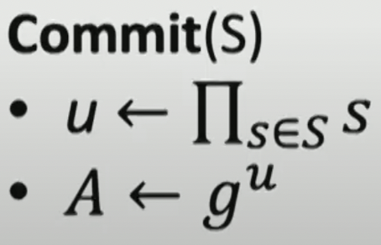
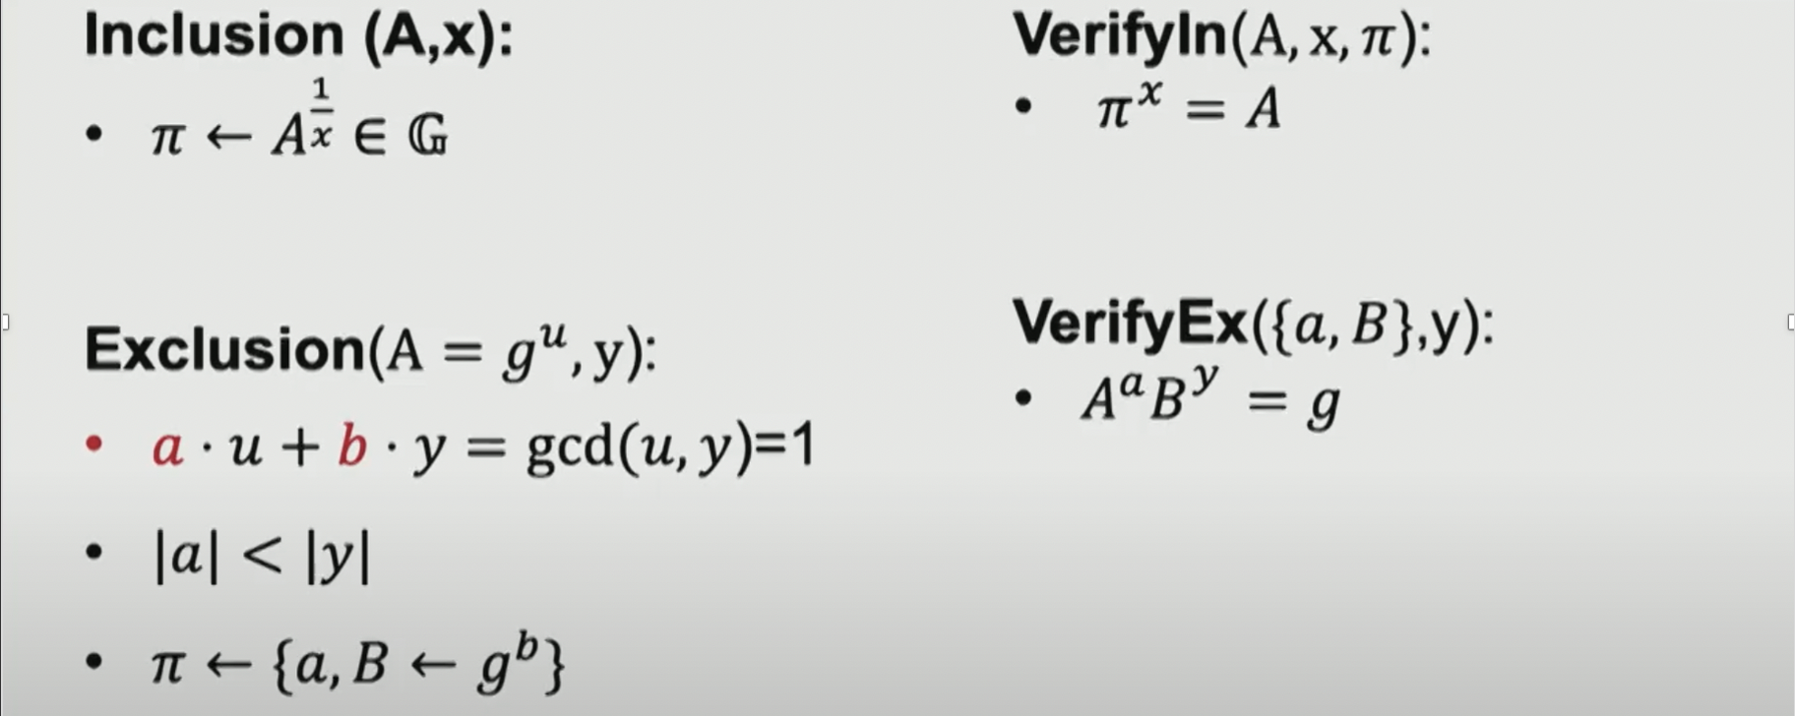
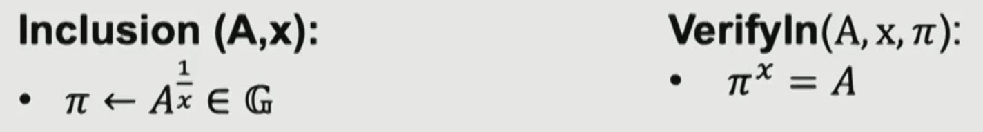

Slide 4
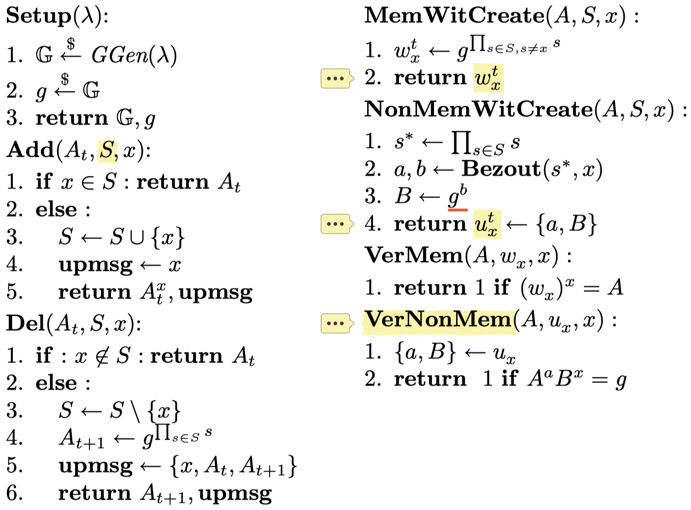
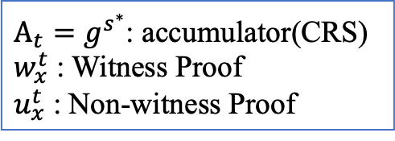
Accumulator[BBF19]
Group With Unknown Order
$A_{t}=g^{s^{∗}}$: accumulator(CRS)
$w_{x}^{t}$ : Witness Proof
$u_{x}^{t}$ : Non-witness Proof

Slide 5
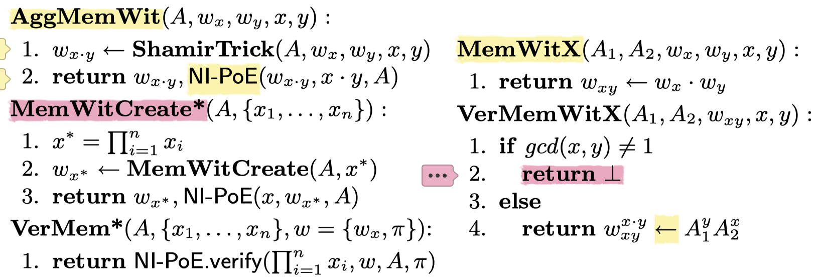
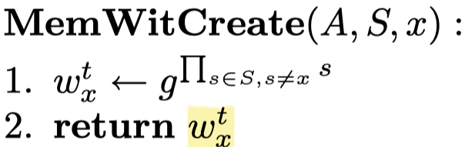
MemWitness Agg
X 右侧: Cross Set Witness Aggregation;
VerMemWitX 存在条件: x 不等于 y ;

Slide 6
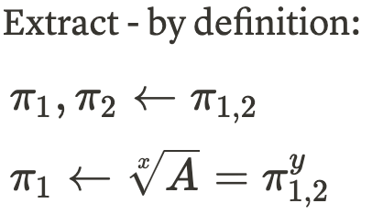
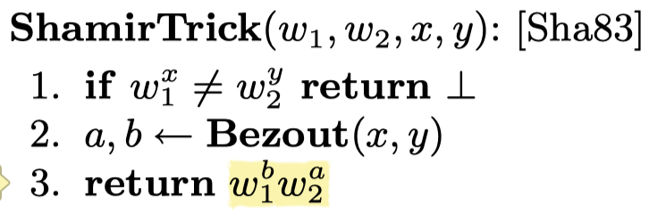
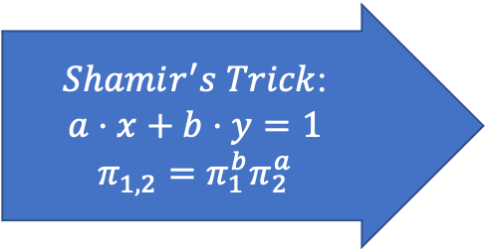
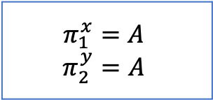
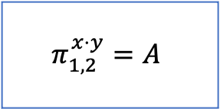
MemWitness Agg
Witness Aggregation: Shamir-Trick
$Shamir^{′}s Trick$:
$$a⋅x+b⋅y=1$$
$$π_{1,2}=π_{1}^{b}π_{2}^{a}$$
$$π_{1}^{x}=A$$
$$π_{2}^{y}=A$$
$$π_{1,2}^{x⋅y}=A$$
Bezout(x, y)
ExtEuclid 求唯一解 (a,b) : ax+by=1

Slide 7
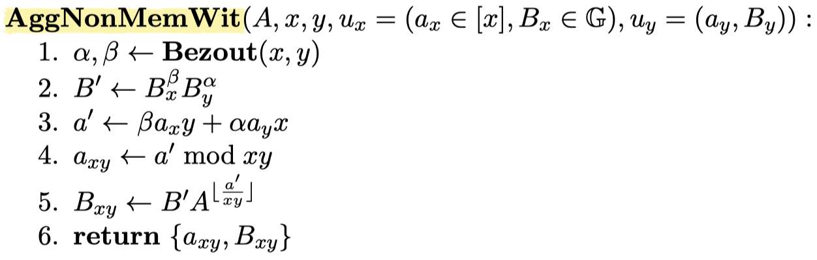
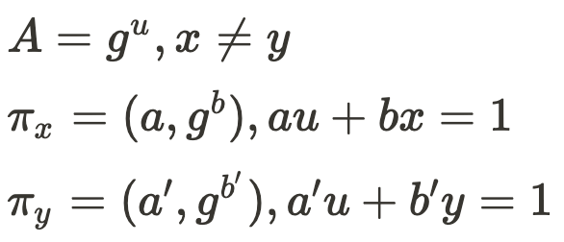
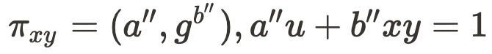
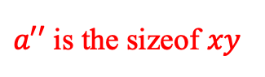
NonMemWit Agg
Agg
$a′′$ is the sizeof $xy$
Notes:
incremental?

Slide 8
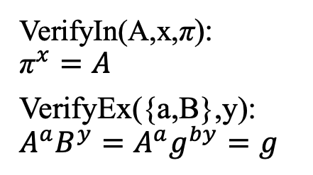
Why PoE
VerifyIn(A,x,π):
$${\text{π}}^{x}=A$$
VerifyEx({a,B},y):
$$A^{a}B^{y}=A^{a}g^{by}=g$$
Unknown Order Group
没有 module
exp 运算没有快速模指数等方案

Slide 9

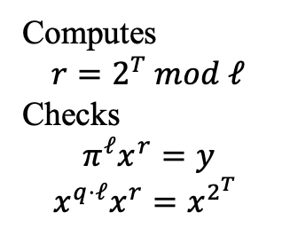
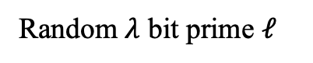
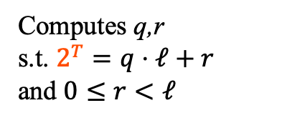
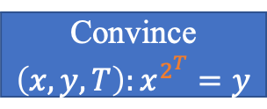
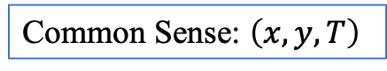
Wesolowski Proof [Wesolowski’18]
Common Sense: $\left(x,y,T\right)$
Convince$\left(x,y,T\right):x^{2^{T}}=y$
y
Random $λ$ bit prime $ℓ$
Prover
$$π=x^{q}$$
Verifier
Computes
$$r=2^{T} mod ℓ$$
Checks
$$π^{ℓ}x^{r}=y$$
$$x^{q⋅ℓ}x^{r}=x^{2^{T}}$$
Computes q,r
s.t. $2^{T}=q⋅ℓ+r$
and $0≤r<ℓ$
Wesolowski, B.: Eﬃcient veriﬁable delay functions.
Cryptology ePrint Archive, Report 2018/623 (2018).

Slide 10

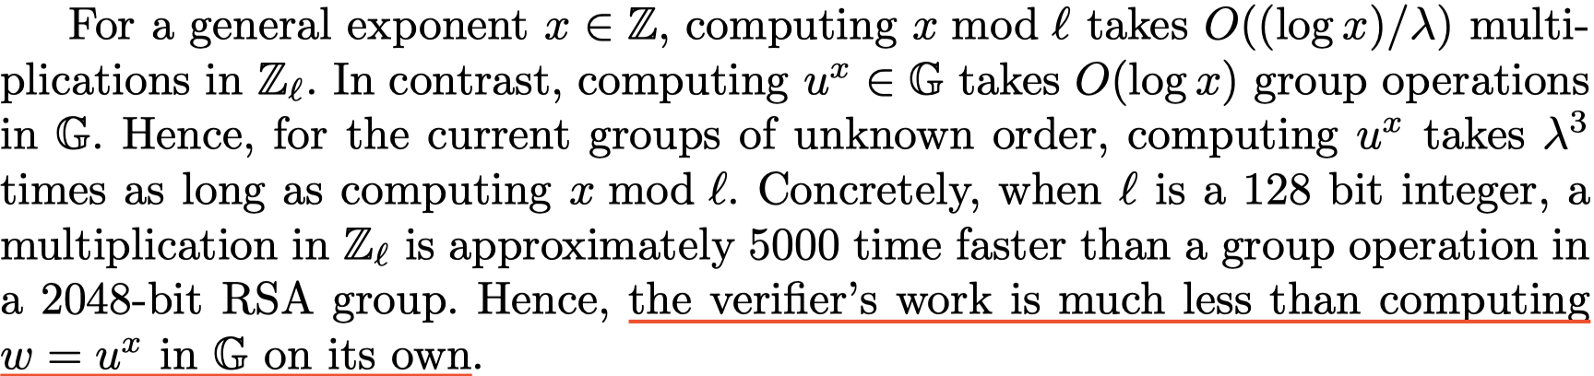
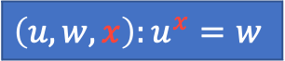
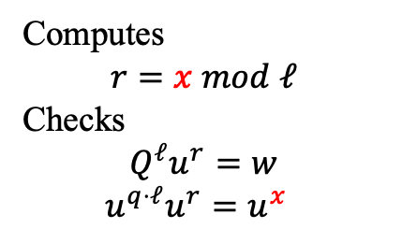
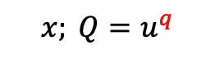
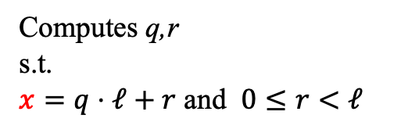
Proof of Exponentiation (PoE)
Witness: x
$$\left(u,w,x\right):u^{x}=w$$
w,u
Random $λ$ bit prime $ℓ$
Prover
$$x; Q=u^{q}$$
Verifier
Computes
$$r=x mod ℓ$$
Checks
$$Q^{ℓ}u^{r}=w$$
$$u^{q⋅ℓ}u^{r}=u^{x}$$
Computes q,r
s.t.
$x=q⋅ℓ+r$ and $0≤r<ℓ$
Performance: n -> Log(n)

Slide 11
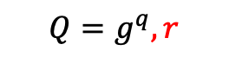
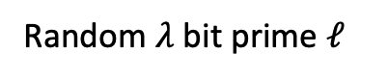
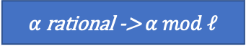

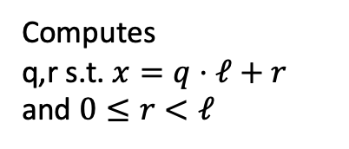
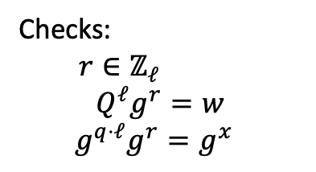
Knowledge of Exponent (PoKE*)
Witness: x
CRS=(g, G)
$$\left(w,x\right):g^{x}=w$$
w
Random $λ$ bit prime $ℓ$
Prover
Verifier
$$Q=g^{q},r$$
Computes
q,r s.t. $x=q⋅ℓ+r$
and $0≤r<ℓ$
Checks:
$r∈ℤ_{ℓ}$
$$Q^{ℓ}g^{r}=w$$
$$g^{q⋅ℓ}g^{r}=g^{x}$$
$α$ rational -> $α mod ℓ$
g 作为 CRS, 降低通信量但是 x 由Prover决定, 容易受欺骗.

Slide 12
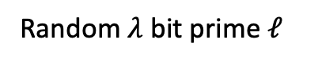
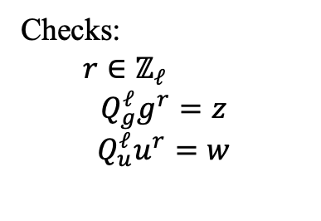
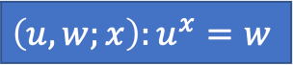
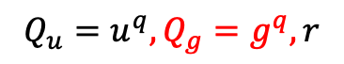
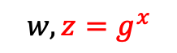
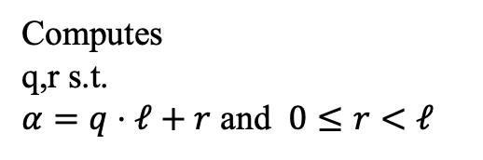
Knowledge of Exponent (PoKE)
Witness: x
CRS=(g, G)
$$\left(u,w;x\right):u^{x}=w$$
$$w,z=g^{x}$$
Random $λ$ bit prime $ℓ$
Prover
Verifier
$$Q_{u}=u^{q},Q_{g}=g^{q},r$$
Computes
q,r s.t.
$α=q⋅ℓ+r$ and $0≤r<ℓ$
Checks:
$r∈ℤ_{ℓ}$
$$Q_{g}^{ℓ}g^{r}=z$$
$$Q_{u}^{ℓ}u^{r}=w$$
额外一个 Q 在降低通讯开销的同时保证了 x 的一致性

Slide 13
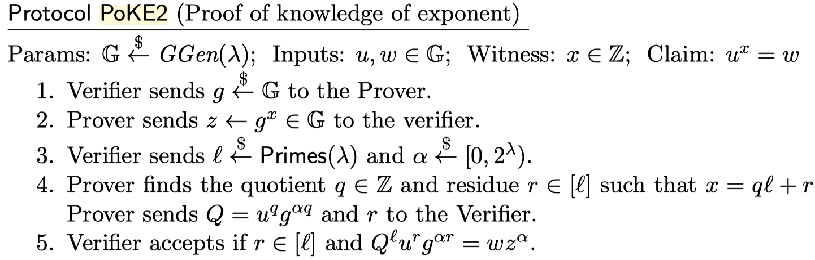
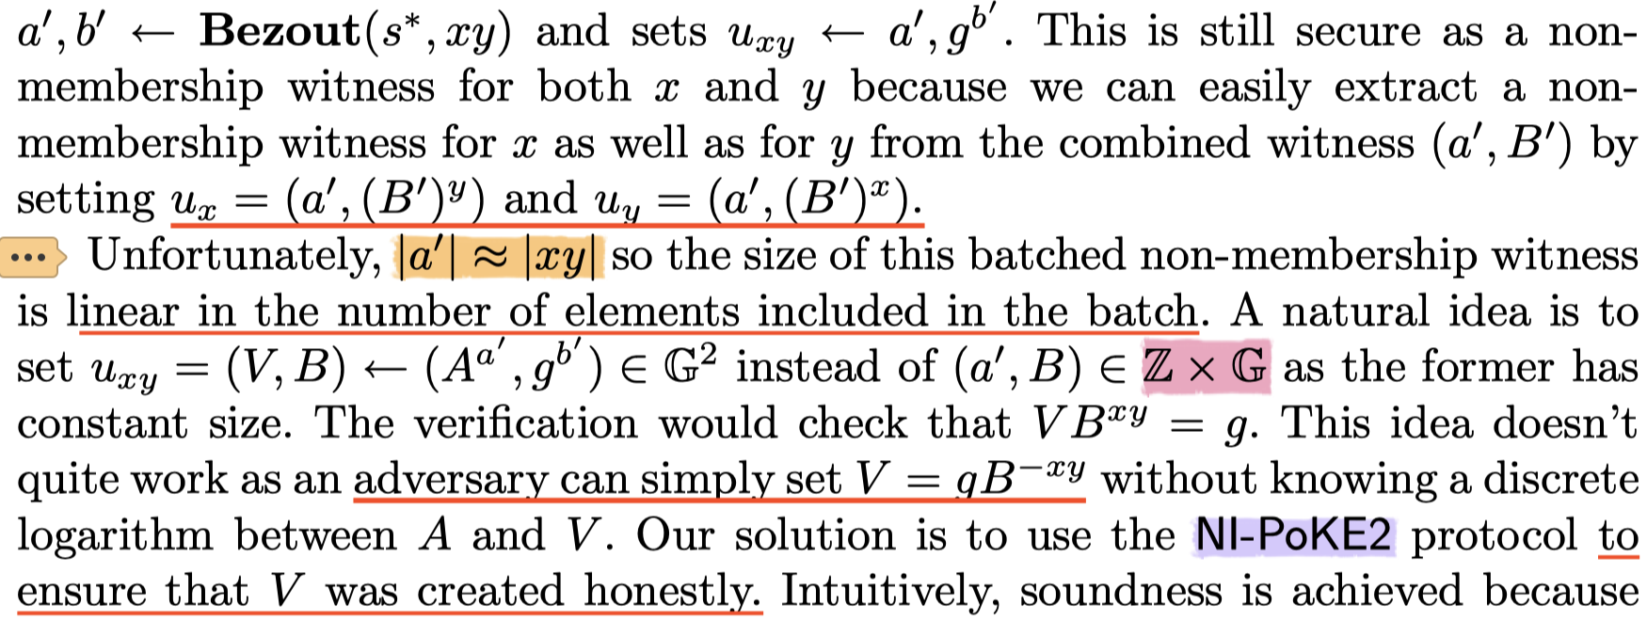
PoKE2

Slide 14
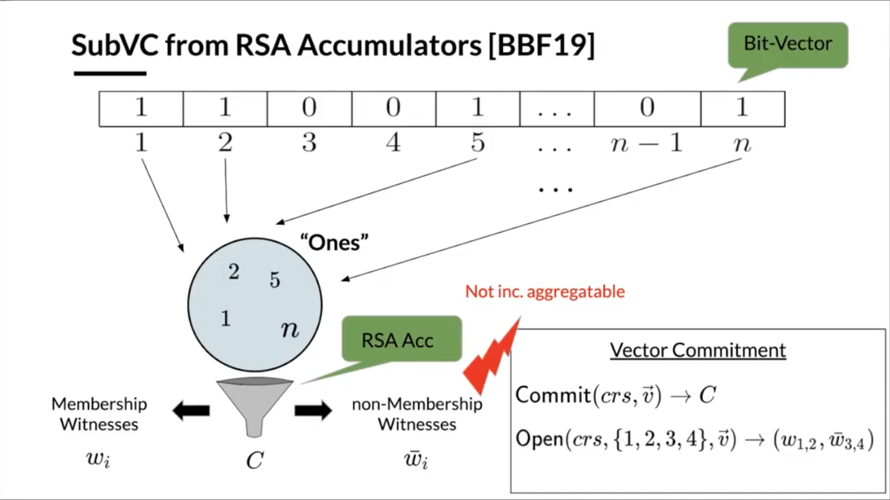
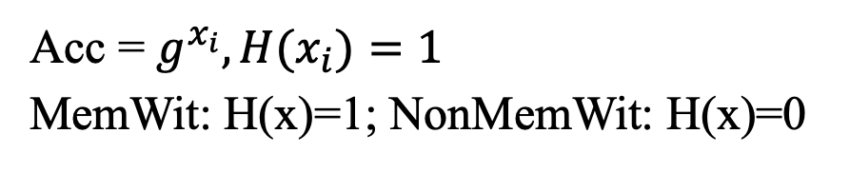
Acc with VC
Acc = $g^{x_{i}},{H(x}_{i})=1$
MemWit: H(x)=1; NonMemWit: H(x)=0

Slide 15
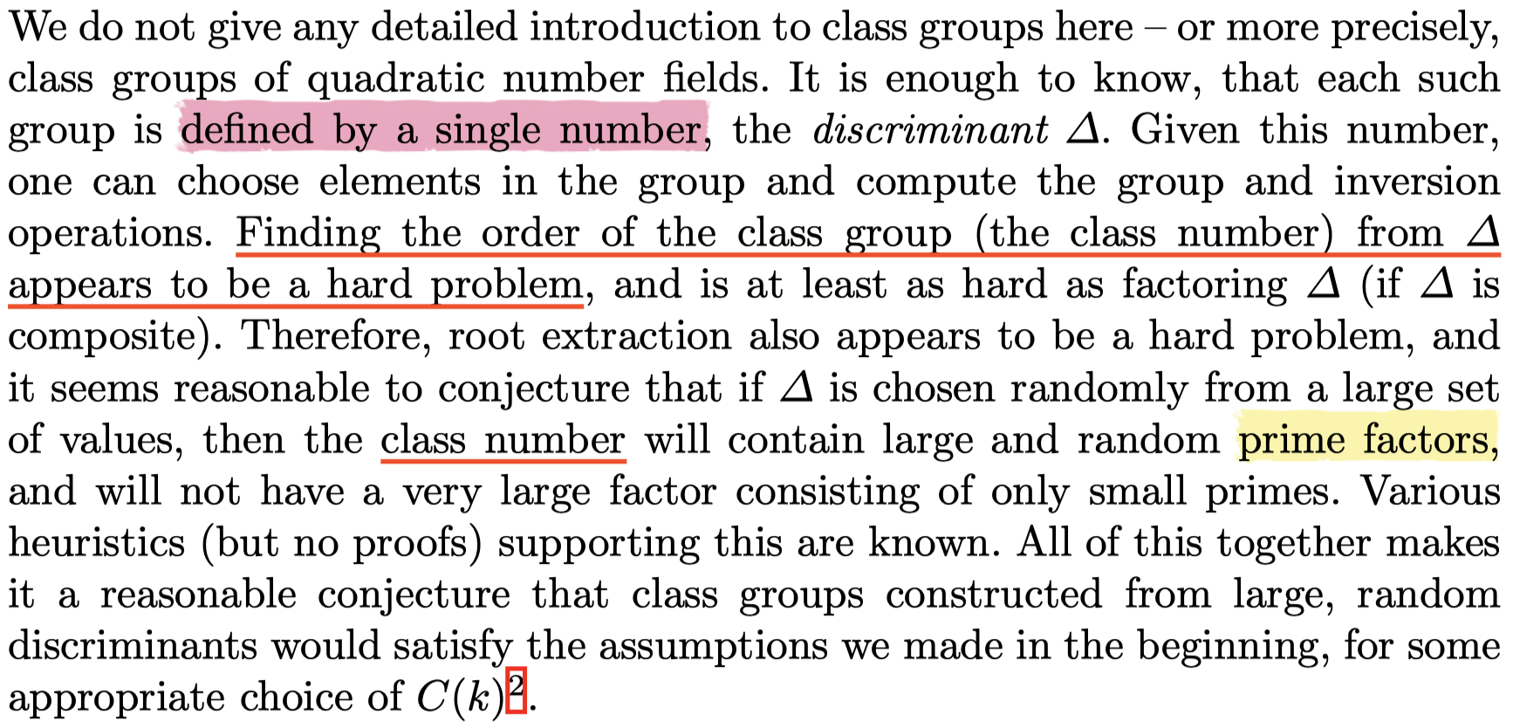
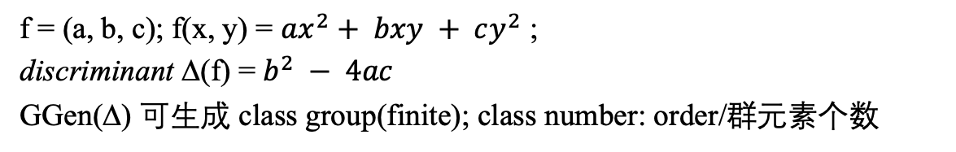
Class Group
Class Group
f = (a, b, c); f(x, y) = $ax^{2}+ bxy + cy^{2}$ ;
discriminant ∆(f) = $b^{2} − 4ac$
GGen(∆) 可生成 class group(finite); class number: order/群元素个数
Ivan Damgård and Eiichiro Fujisaki, “A Statistically-Hiding Integer Commitment Scheme Based on Groups with Hidden Order,” in Advances in Cryptology — ASIACRYPT 2002, ed. Yuliang Zheng, Lecture Notes in Computer Science (Berlin, Heidelberg: Springer, 2002), 125–42, https://doi.org/10.1007/3-540-36178-2_8.

Slide 16




Class Group
Hard to compute order of group
Damgård and Koprowski, “Generic Lower Bounds for Root Extraction and Signature Schemes in General Groups.”
Dobson, Galbraith, and Smith, “Trustless Groups of Unknown Order with Hyperelliptic Curves.”
Lipa Long, “binary quadratic form”, https://github.com/Chia-Network/vdf-competition/blob/master/classgroups.pdf

Slide 17
One of the main security assumptions their construction uses is that it relies on a group of unknown order.
In particular the strong RSA assumption must hold, meaning it is hard to compute a chosen root of a random group element.
Michael Straka “Class Groups for Cryptographic Accumulators”, https://www.michaelstraka.com/posts/classgroups/

Slide 18


Slide 19


Slide 20


Security Assumption
Assumption 1: strong RSA assumption
One of the main security assumptions their construction uses is that it relies on a group of unknown order.
In particular the strong RSA assumption must hold, meaning it is hard to compute a chosen root of a random group element.
Assumption 1: strong RSA assumption

Slide 21


Slide 22


